Slide 1
Dual Credit with Carl Sandburg College: Save Money, Save Time
Presented by:
Megan Jones
Coordinator of Recruitment and Dual Credit
Carl Sandburg College

Slide 2
Eligibility
Must meet minimum academic requirements.
ACCUPLACER scores- Reading 247 or higher, Math 256 in Quantitative Reasoning or 251 in Advanced Algebra
SAT scores: 480 in reading and writing, 530 for Math
Must meet any prerequisites.
For example, BIO 211- Anatomy and Physiology I you must have BIO 101- General Biology and CHM 100- Concepts of Chemistry
Must have permission from high school to receive high school credit for college courses.

Slide 3
Benefits of Dual Credit
Less Expensive
Convenience and comfort of taking classes at local high school or online
Lighten college course load to finish degree sooner or to allow time for sports, activities and employment while in college
Gain experience to prepare for the academic rigor and expectations of college coursework

Slide 4
Additional Benefits
Minimizes other potential costs (room & board, travel)
Sandburg’s Dual Credit Scholarship!
A one-time award of $1500 for your first year at Sandburg. Must have completed all dual credit classes with a C or above. Must have 6 credit hours in dual credit to be considered. Cannot be from a Promise school.
Notes:
Give more information on Sandburg’s Dual Credit Scholarship and what it is about.

Slide 5
Transferability
Most credits may be used to finish an associate degree at Carl Sandburg College (Dual Credit Plus One Program)
IAI coursework (Illinois Articulation Initiative agreement) enhances transferability to other Illinois colleges and universities (see your high school counselor)
Many credits may also apply to an occupational degree or certificate at Sandburg

Slide 6
High School vs. College
High School
College
Typically 10 < hrs. per week total
Rate at which material is covered seems manageable
Assistance breaking down large assignments
Memorization emphasized
Fed information need to know
Grades based on larger number of activities
Expect 6 hrs./week per course
Rate at which material is covered seems overwhelming
Challenge of work overwhelming
Application of ideas emphasized
Expected to learn outside of class on own
Grades may be based on small number of activities

Slide 7
Sandburg’s Tuition Costs
$170 a credit hour- could go up to $175 per credit hour in the fall
$510 for a typical three credit hour course + $25.00 registration fee = $535.00
Dual Credit Scholarship: ½ price for up to six credit hours a semester
$510.00- $255.00 +$25 = $280.00
525.00 – 262.50 + 25 = 287.50(if tuition increases in fall)
***Based on 2018-19 tuition rate, plus a $25 registration fee each semester, costs for books not included.

Slide 8
Text Book Information
Students are responsible for finding out if books are required for their class. They can go to www.sandburg.edu/bookstore to find the information. Or they can go to the class schedule on the website to find the ISBN number for the book needed. Some classes will be OER- open educational resource which means the instructor will provide the material

Slide 9
Dual Credit PELL funds
The U.S. Department of Education has selected Carl Sandburg College to participate in an experimental program that allows students enrolled in dual credit classes to receive Pell Grants. The Pell Grant program provides monetary assistance to students demonstrating financial need. The maximum award, is $5920 for the 2017-18 academic year. To apply for Pell, families must complete the Free Application for Federal Student Aid (FAFSA).

Slide 10
Financial Aid
Notes:
.

Slide 11
mySandburg and Financial Aid
Allows students (and Parent Proxy) to access your account online
Sign in at www.sandburg.edu and choose mySANDBURG
View Documents required
My Awards
Satisfactory Progress Status
Student billing, payments and payment plan

Slide 12
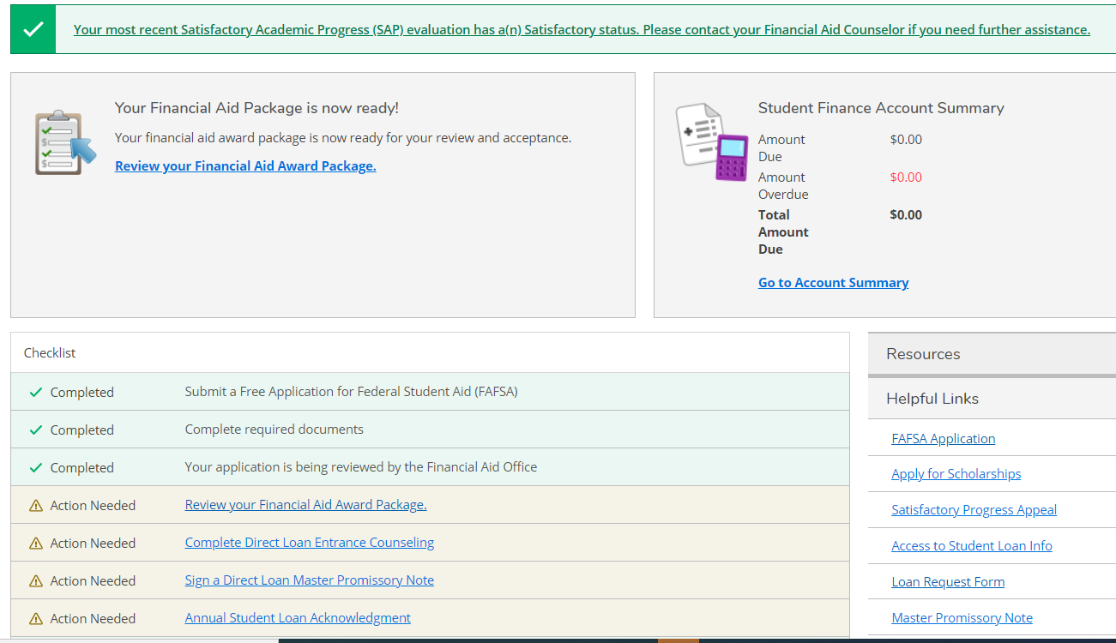
Self Service Home Page
Notes:
Faculty & staff: If calling, leave a voicemail. Usually with another student or might be away from desk, so its better to leave a message so they can call you back
Tutoring Center: Walkins welcome, no appointment needed; trained tutors available on wide variety of subjects; online tutoring available 24/7 at tutor.com
Library: online databases, inter-library loan network
Testing Center: Must have approval from instructor, and must make appointment to take test; preferably 24 hours or more in advance.

Slide 13
Documents Required

Slide 14
Satisfactory Progress
To continue receiving financial aid, students must successfully complete their courses with acceptable grades
2.0 cumulative grade point average
67% cumulative completion rate
Complete your degree within the maximum timeframe
Reviewed at the end of each term
Opportunity to appeal
Complete policy available online

Slide 15
Six Years -Pell Grant Lifetime Limit
Freshman 1
Freshman 2
Sophomore
Junior
Senior
Extra
Part Time
Part Time
Full Time
Full Time
Full Time
Optional
Extra
Optional
Federal Pell Grant Eligibility is limited to 6 years at full-time enrollment.
Once a student has reached the Lifetime Eligibility Limit he/she can longer receive Pell funds.
Pell Received for enrollment in Dual Credit classes counts toward the 6 year limit.

Slide 16
Billing - If you owe tuition and fees
Payments in person, online, by phone or mail
Deferred Payment Option Available
$35 fee, no interest, requires credit card or bank account
Refund period
Student Account information provided online
Business Office 309.341.5210

Slide 17
Important dates
“No Show; You Go”- must attend your classes in person or log-in to an online class all week that first week of school.
Tuition/fee due date- Fall tuition due August 10
Refund Period- must drop a class within the first 9 days of the 16-week semester to get a 100% refund.
Withdrawal Dates- be aware of the last day to drop for the semester so you don’t take a bad grade in the class.

Slide 18
Don’t be afraid to ask questions and seek help! Use your resources.
Instructors
High School Counselor
Library
Atomic Learning
Tech Help Desk
Academic Advisors: career exploration, creating a plan, transferring, etc.
Academic Support Services: disability & tutoring
Starfish retention alert- emails sent to your Sandburg email. Check regularly for progress!!

Slide 19
Things to remember
Grades will be shared with high school
Eligibility for athletics/extra curricular events
Classroom policies
Student code of conduct - plagiarism

Slide 20
Questions???
Contact Megan Jones at 309-341-5229 or mjones@sandburg.edu

Slide 21
Thank you for attending!

